Slide 1
Data sharing and Backup
We will be using an electronic whiteboard (Etherpad).
Please log onto your computer and access: https://public.etherpad-mozilla.org/p/2019-2-26-cruk-ci-myrd
Anne Pajon
26th February 2019
This work is licensed under a Creative Commons Attribution 4.0 International License.

Slide 2
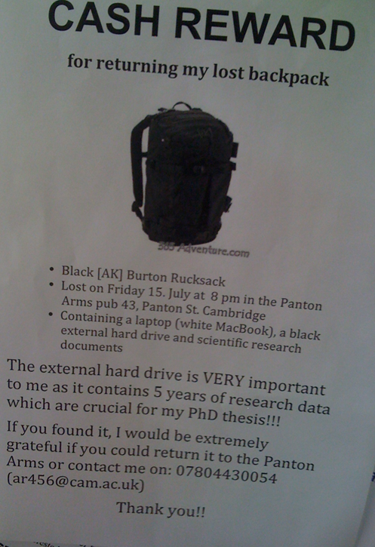
To avoid data disasters ... What would you do if you’d lose your data tomorrow?
xxxxxxxxxxx
xxxxxxxxxxxxx
https://blogs.ch.cam.ac.uk/pmr/2011/08/01/why-you-need-a-data-management-plan/

Slide 3

What if?
Cancer Research UK – University of Manchester – 27 April 2017
Notes:
Why file organization of your research data is important
Specific techniques for organizing your research data,
including developing plans for:
– File structures - where to put data so you won’t lose it
(including tips on embedding metadata)
– File naming - what to call data so you know what it is
– A bit on version control - keeping track of data
• Will also include opportunities for:
– Small group discussion
– Exercise for organizing your own data
• Focuses on research data, but applies to other types of files as well

Slide 4

What would you do if you’d lose your data tomorrow?
Your laptop got stolen
Your office/house burnt
Your USB stick is lost
Your portable hard disk is damaged
Your data in Dropbox disappeared
https://en.wikipedia.org/wiki/The_Scream
Notes:
Why file organization of your research data is important
Specific techniques for organizing your research data,
including developing plans for:
– File structures - where to put data so you won’t lose it
(including tips on embedding metadata)
– File naming - what to call data so you know what it is
– A bit on version control - keeping track of data
• Will also include opportunities for:
– Small group discussion
– Exercise for organizing your own data
• Focuses on research data, but applies to other types of files as well

Slide 5
Never work directly on the raw data
Leave it intact
Always make a copy, and work on the copy

Slide 6
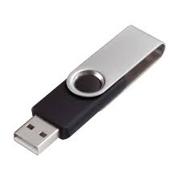
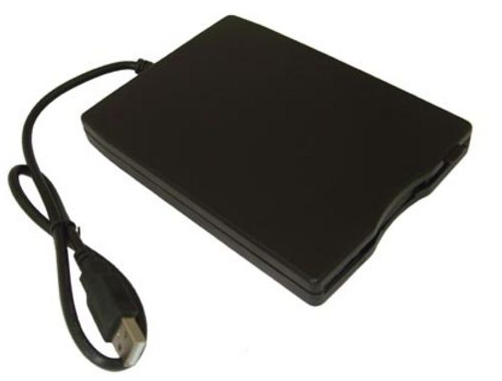

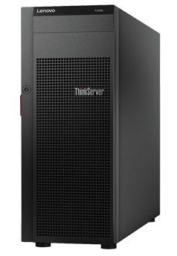




Data backup
At least 2 backups at 2 different locations
External disks
Online backup
Servers
Department
College
IT
Cheap
£10-15 / TB (1024GB)
Accessibility
Free (limit)
Managed by experts
Failure rate
1.5%/year
Personal data
Hacking
Moving between institutions

Slide 7

Data backup
Manual
Automated
- Install software
e.g. Time machine (Mac users)
Copying files to relevant folders
- RAID technology
- Checksums
Automatically upload files to the cloud when any changes are saved
Copying files to relevant folders

Slide 8



If manual … how often?
How much would you be willing to lose?
1 day
1 week
1 month-year
Software allows you to set up backup time
automatically

Slide 9
Data backup and file sharing
Space/price
2 GB (free)
1TB (£96/year)
15 GB (free)
1 TB (£80/year)
5 GB (free)
1 TB (£56)
File history and recovery
Yes, unlimited
Yes
Last 90 days
File size limit
None
5 GB
15 GB
Support
UIS
UIS
UIS
OS
Windows, Mac, Linux,
Android, iOS
Windows, Mac,
Android, iOS
Windows, Mac,
Android, iOS
Accessibility
Sync anywhere on any devices
Live editing
Integration with Microsoft Office

Slide 10



More … file sharing
Email
Website
FTP

Slide 11
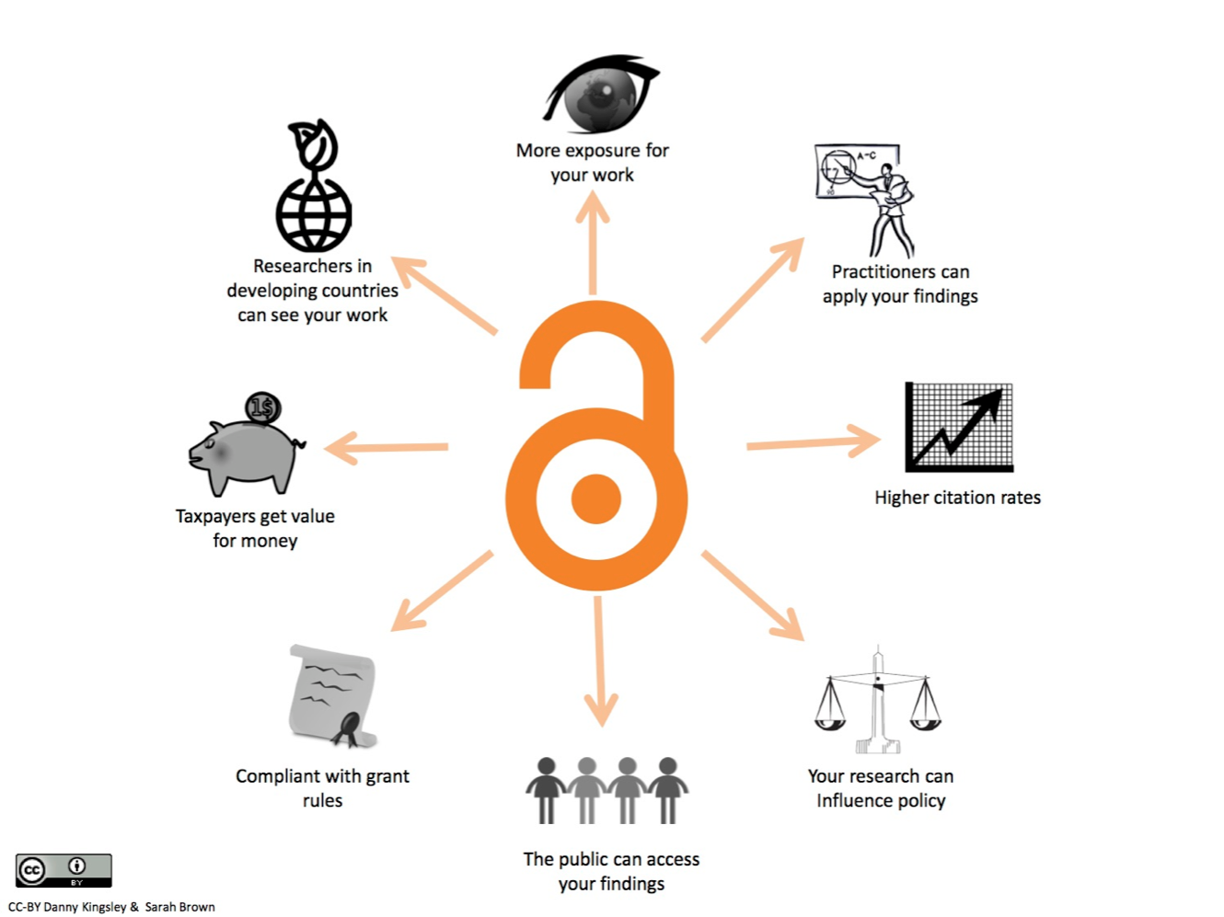
Why data sharing is important?
Data should be shared to move our knowledge forward

Slide 12



What data to share?
Raw data and associated metadata
Software and scripts
Methods used
Processed data
Papers
results and figures
What about non-positive results?
RIO - Research Ideas and Outcomes
Would you consider Pre-Print for your draft manuscripts?
https://riojournal.com/
https://doaj.org/
https://www.biorxiv.org/

Slide 13
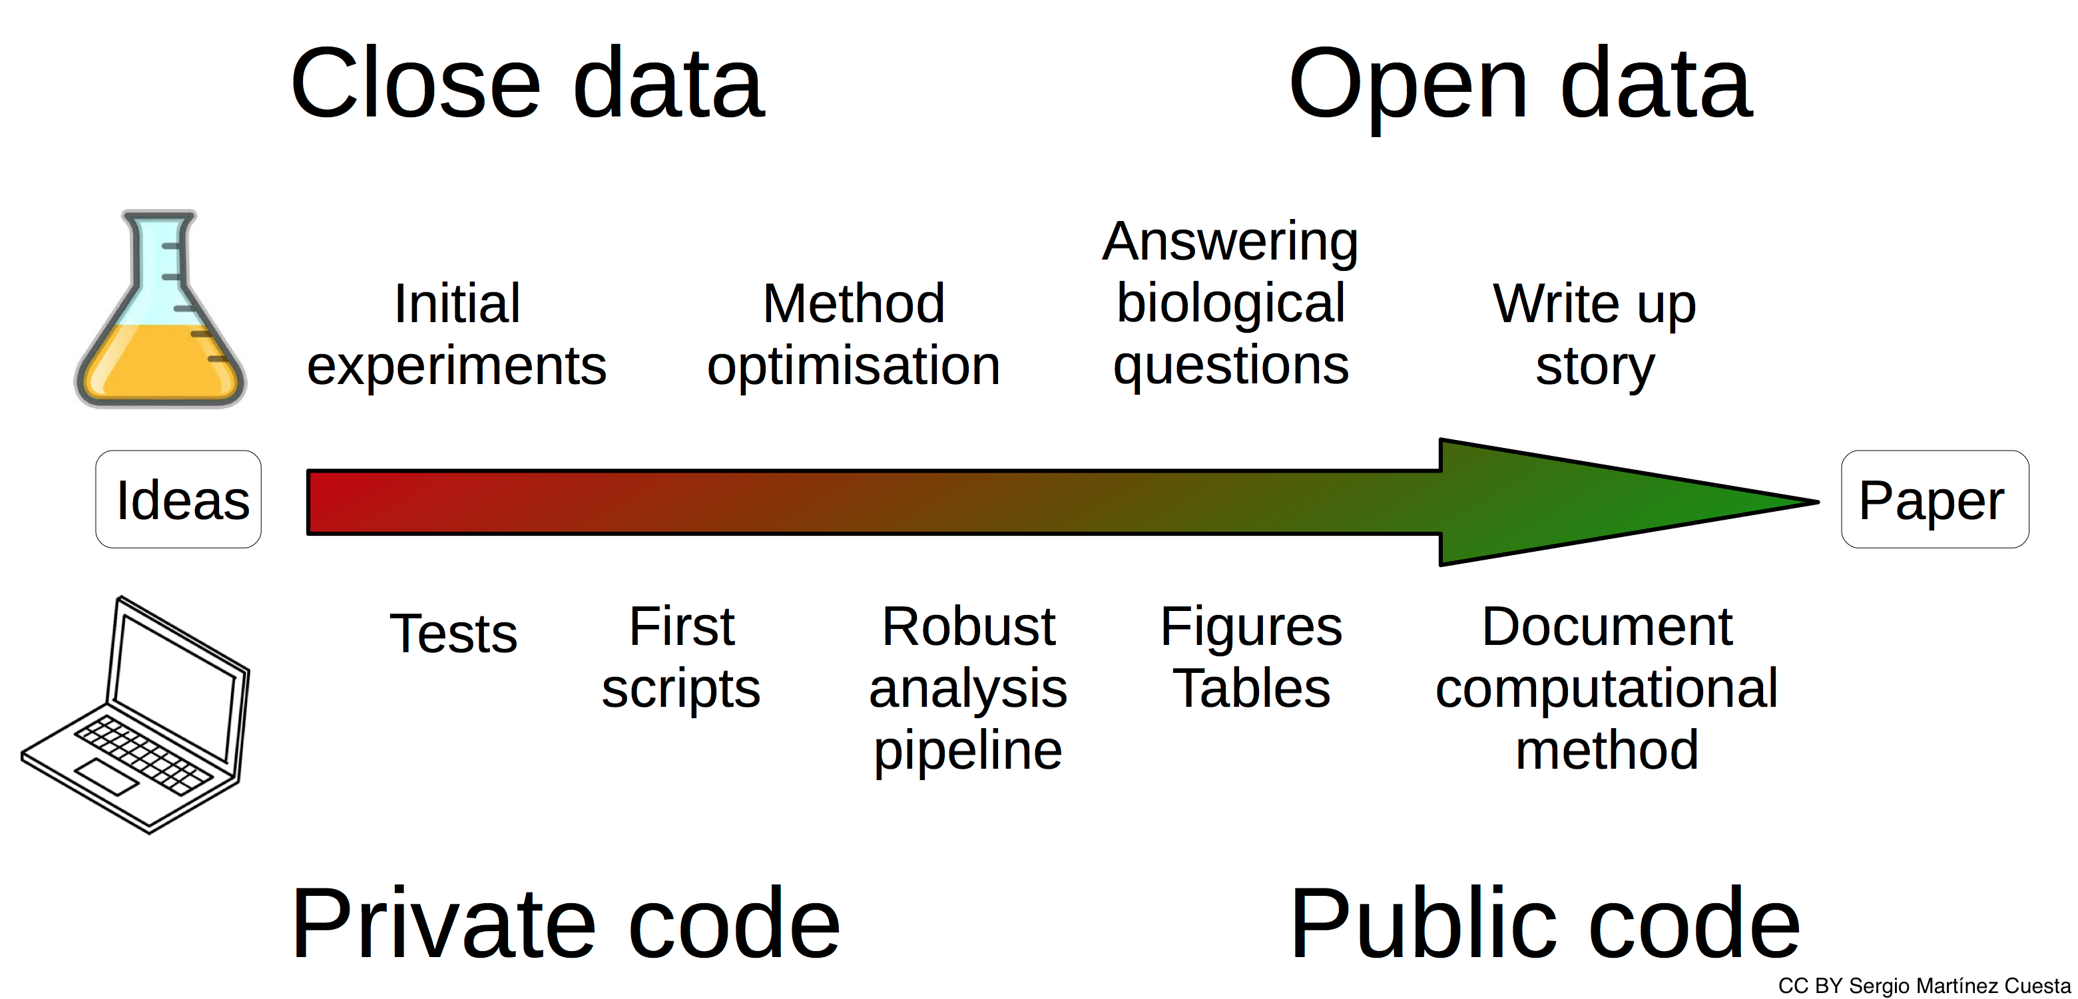
When to share?

Slide 14
Gather information early
Think of data submission from the start
Collect metadata before submission
Keep a ReadMe file about your project
Consider using an electronic notebook

Slide 15
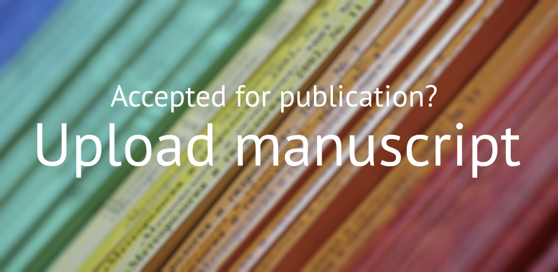


Making your publication Open Access
The Open Access Team will check your funder and journal policies and advise on how to comply with Open Access requirements.
https://www.openaccess.cam.ac.uk/

Slide 16



How to share your data?
Store, describe and deposit your data in suitable and trusted public data repositories and add a link to your data in your publication.
Repositories for datasets
Discipline specific
Registry of Research Data Repositories http://www.re3data.org/
EMBL-EBI services https://www.ebi.ac.uk/services
General purpose
Zenodo https://zenodo.org/
Repositories for software
GitHub https://github.com
GitLab https://gitlab.com
Bitbucket https://bitbucket.org
Zenodo assigns a Digital Object Identifier (DOI) to make the upload easily and uniquely citeable, with GitHub integration to enable tracking of each release.

Slide 17

Open Science Framework
Cloud-based management for your projects @ https://osf.io/

Slide 18
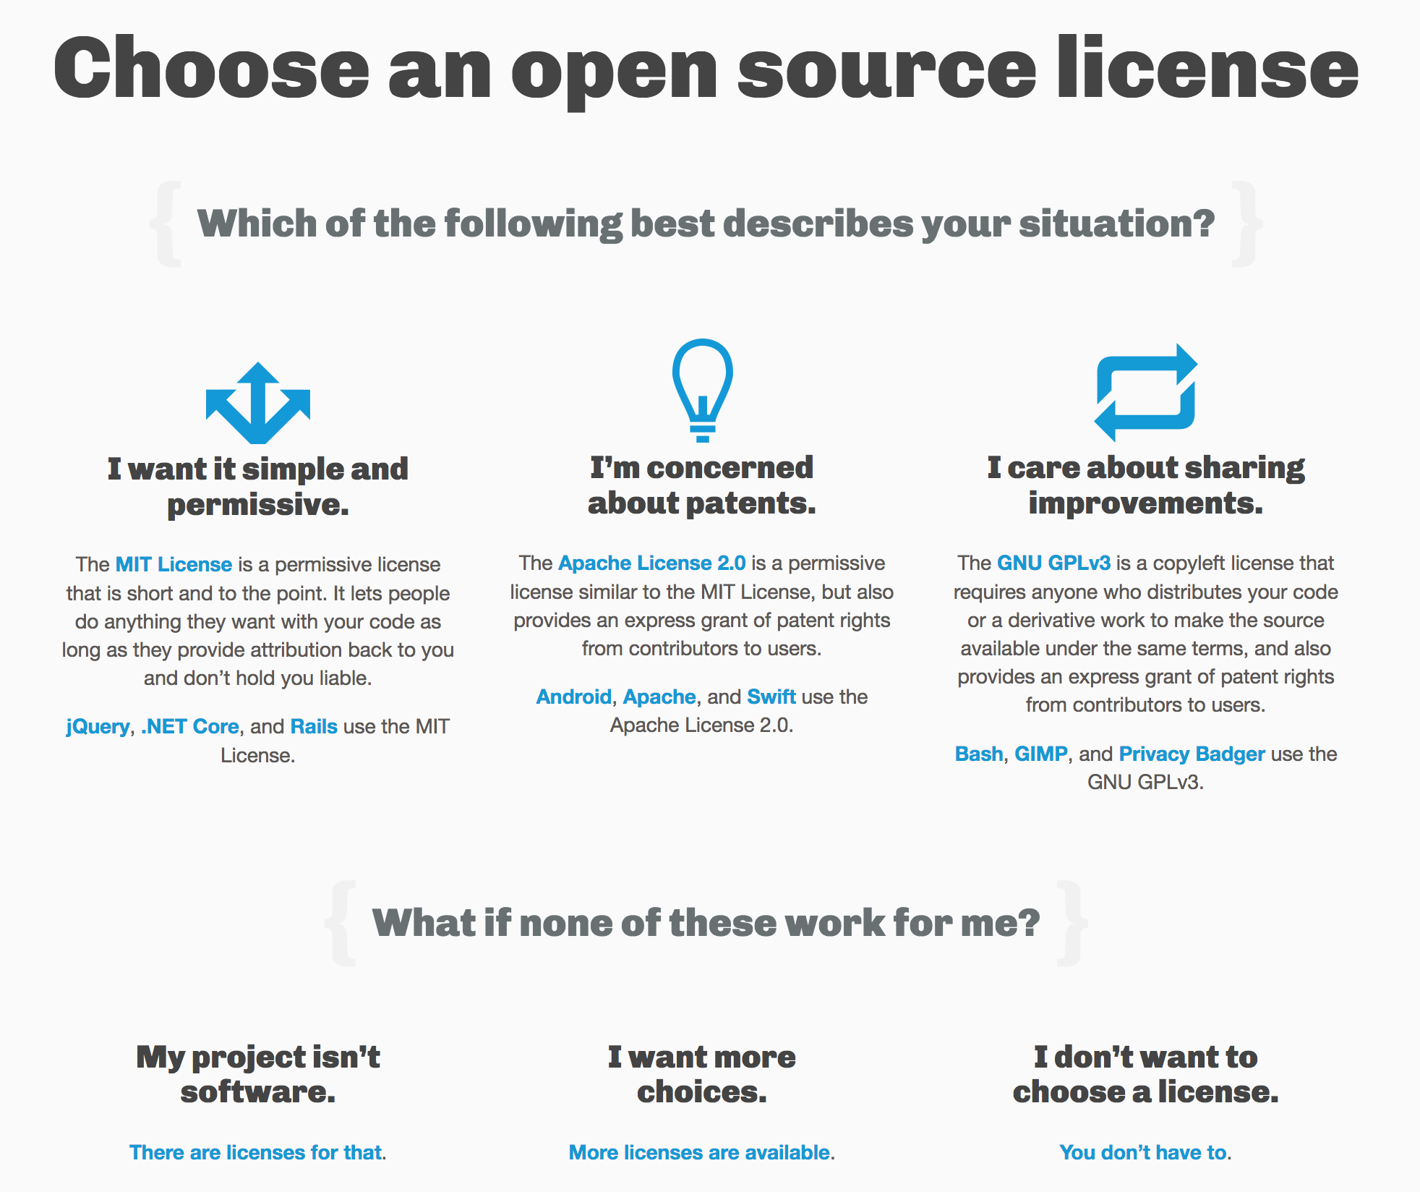
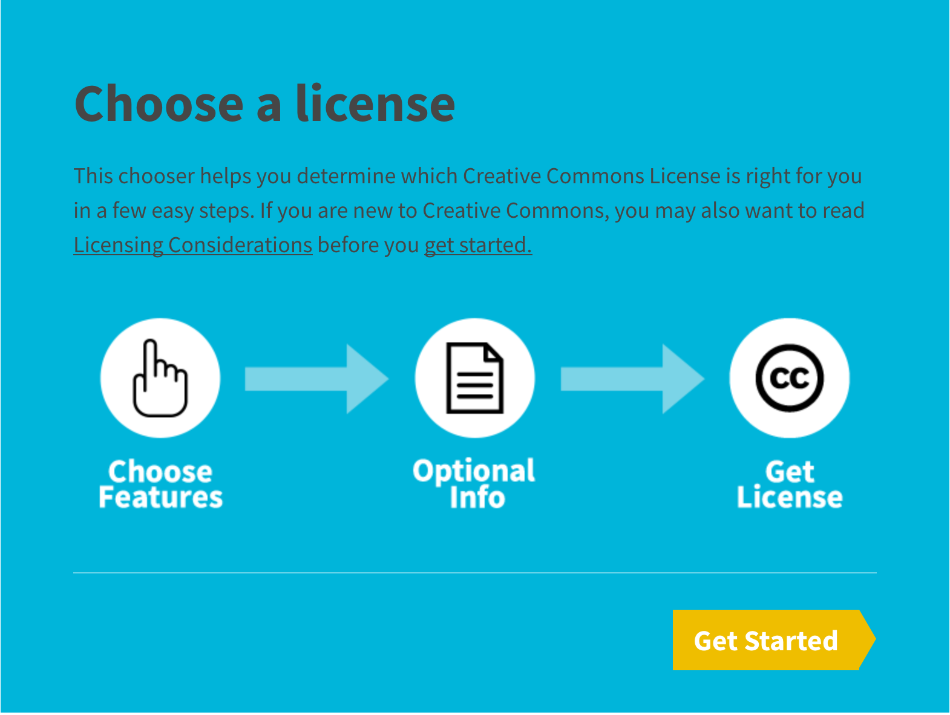
Under which license?
Share your work with one of the Creative Commons licenses
Software licenses
https://choosealicense.com
https://creativecommons.org/

Slide 19

Conclusion
Always make a copy of your raw data
Backup your data at least twice at two different locations
Document your process using a ReadMe file
Ideally most data should be shared
Sharing is essential for all publicly funded research
Share as early as possible
Using suitable repositories and DOI
Under Creative Commons or Open Source license

